Slide 1
Unit 6: Recursion
Compiled By:
Ghanashyam BK

Slide 2
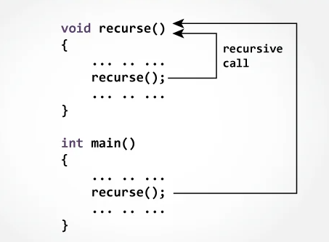
Introduction
The process in which a function calls itself directly or indirectly is called recursion.
The corresponding function is called a recursive function.
Using a recursive algorithm, certain problems can be solved quite easily. Examples of such problems are
TOH, Fibonacci Series, factorial, reversing an integer, checking prime number
we should provide a certain case in order to terminate this recursion process.

Slide 3
Principle of Recursion
A recursive function has two different parts.
The base case and the recursive case.
The base case is used to terminate the task of recurring. If base case is not defined, then the function will recur infinite number of times
In computer program, when we call one function, the value of the program counter is stored into the internal stack before jumping into the function area.
After completing the task, it pops out the address and assign it into the program counter, then resume the task.
During recursive call, it will store the address multiple times, and jumps into the next function call statement.
If one base case is not defined, it will recur again and again, and store address into stack. If the stack has no space anymore, it will raise an error as “Internal Stack Overflow”.

Slide 4
Example
One example of recursive call is finding the factorial of a number.
We can see that the factorial of a number n = n! is same as the n * (n-1)!, again it is same as n * (n - 1) * (n - 2)!.
So if the factorial is a function, then it will be called again and again, but the argument is decreased by 1.
When the argument is 1 or 0, it will return 1. This could be the base case of the recursion.
int fact(int n)
{
if (n < = 1) // base case
return 1;
else
return n*fact(n-1);
}

Slide 5
Recursion vs. Iteration
Recursion | Iteration
Terminates when the base case becomes true. | Terminates when the condition becomes false.
Used with functions. | Used with loops.
Every recursive call needs extra space in the stack memory. | Every iteration does not require any extra space.
Smaller code size. | Larger code size.

Slide 6
Advantages of Recursion
The code may be easier to write.
To solve such problem which are naturally recursive such as Tower of Hanoi.
Extremely useful while applying the same solution.
Recursion reduce the length of code.
It is very useful in solving the data structure problem.

Slide 7
Disadvantages of Recursion
Recursive function are generally slower than non-recursive function.
It may require a lot of memory space to hold intermediate results on the system stacks.
Hard to analyze or understand the code.
It is not more efficient in terms of space and time complexity.
The computer may run out of memory if the recursive calls are not properly checked.
In recursive we must have an if statement somewhere to force the function to return without the recursive call being executed, otherwise the function will never return.

Slide 8
Types of Recursion
Mainly of two types depending on whether a function calls itself from within itself or more than one function call one another mutually.
The first one is called direct recursion and
another one is called indirect recursion.
Direct Recursion:
These can be further categorized into four types:
Tail Recursion
Head Recursion
Tree Recursion
Nested Recursion
Indirect Recursion

Slide 9
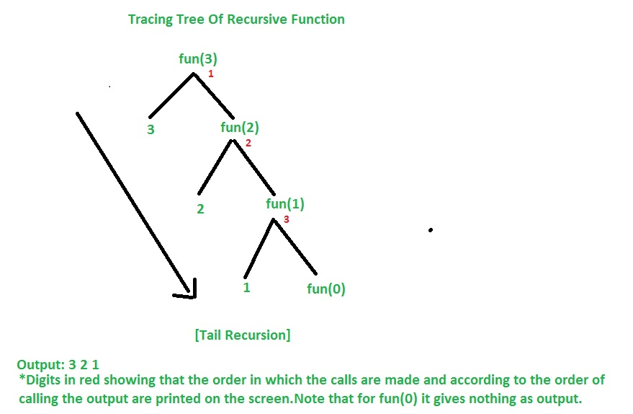
Tail Recursion
If a recursive function calling itself and that recursive call is the last statement in the function then it’s known as Tail Recursion.
After that call the recursive function performs nothing.
The function has to process or perform any operation at the time of calling and it does nothing at returning time.
Example:
void fun(int n){
if (n > 0) {
printf("%d ", n);
fun(n - 1);
}
}

Slide 10
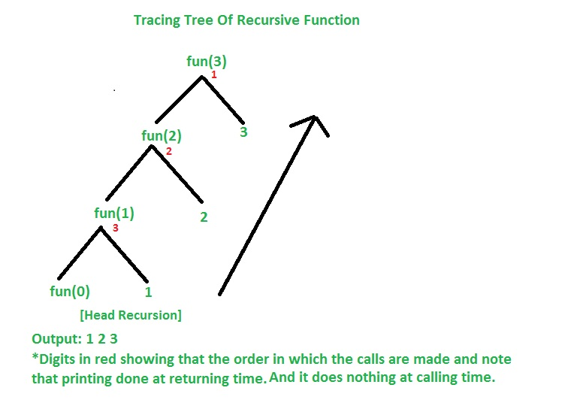
Head Recursion
If a recursive function calling itself and that recursive call is the first statement in the function then it’s known as Head Recursion.
There’s no statement, no operation before the call.
The function doesn’t have to process or perform any operation at the time of calling and all operations are done at returning time.
Example:
void fun(int n){
if (n > 0) {
fun(n - 1);
printf("%d ", n);
}
}

Slide 11
Tree Recursion
To understand Tree Recursion let’s first understand Linear Recursion.
If a recursive function calling itself for one time then it’s known as Linear Recursion.
Otherwise if a recursive function calling itself for more than one time then it’s known as Tree Recursion.
Example: Linear Recursion
fun(n){
if(n>0)
{
fun(n-1); // Calling itself only once
}
}
Example: Tree Recursion
void fun(int n){
if (n > 0) {
printf("%d ", n);
fun(n - 1); //Calling Once
fun(n - 1); //calling twice
}
}

Slide 12
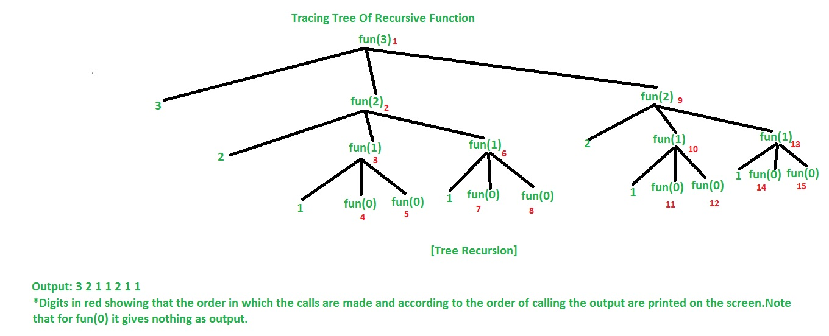
Tree Recursion

Slide 13
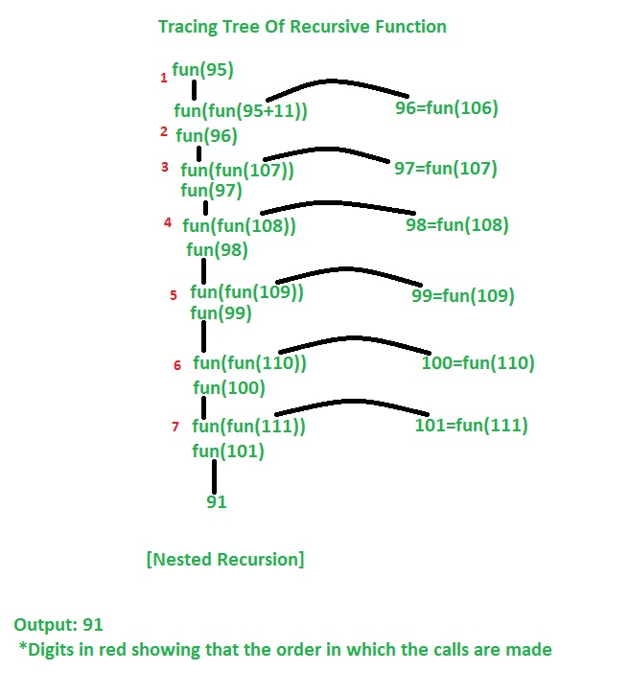
Nested Recursion
In this recursion, a recursive function will pass the parameter as a recursive call.
That means “recursion inside recursion”.
Let see the example to understand this recursion.
Example:
int fun(int n){
if (n > 100)
return n - 10;
// A recursive function passing parameter as a recursive call or recursion inside the recursion
return fun(fun(n + 11));
}

Slide 14
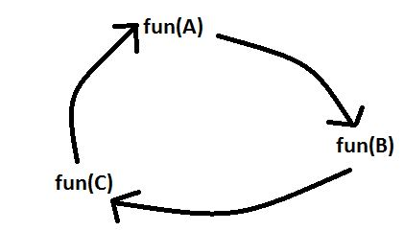
Indirect Recursion
In this recursion, there may be more than one functions and they are calling one another in a circular manner.
From the above diagram fun(A) is calling for fun(B), fun(B) is calling for fun(C) and fun(C) is calling for fun(A) and thus it makes a cycle.
void funA(int n){
if (n > 0) {
printf("%d ", n);
funB(n - 1); // Fun(A) is calling fun(B)
}
}
void funB(int n){
if (n > 1) {
printf("%d ", n);
funA(n / 2); // Fun(B) is calling fun(A)
}
}

Slide 15
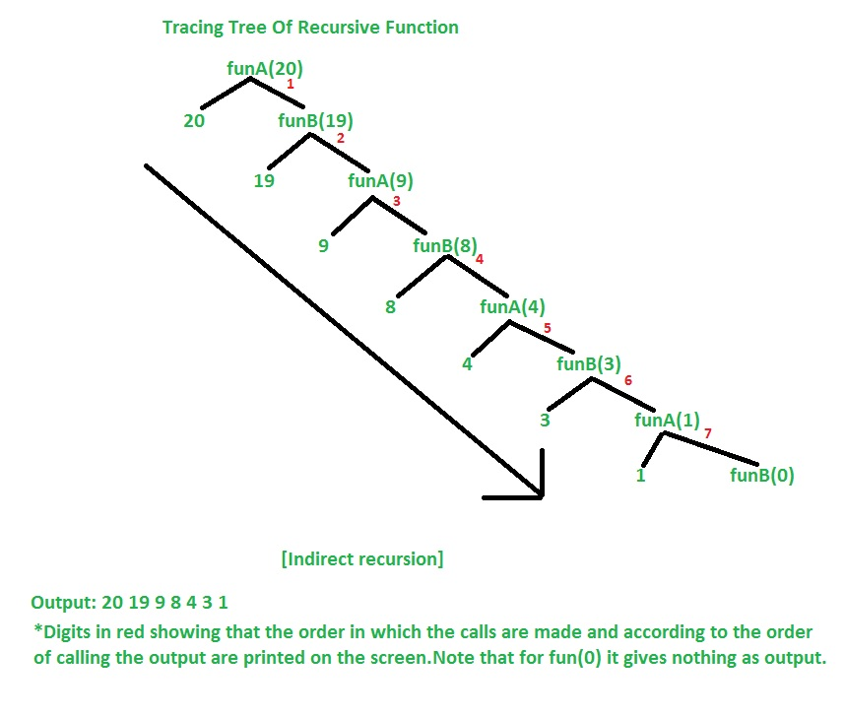
Indirect Recursion

Slide 16
Application of Recursion
Tree Data Structure:
The most important data structure ‘Tree’ doesn’t exist without recursion. We can solve that in an iterative way also but that will be a very tough task. For smaller problems the iterative way will work fine but for the larger tree the iterative way will become the headache to use. because as the tree size will increase the size of the code too will increase. But with the help of recursion the size of the code will become drastically small.
Sorting Algorithms
Most of the sorting algorithms uses the concept of recursion to sort the data according to the given condition. Many of the Sorting algorithms like Quick sort, Merge sort, etc. Uses the recursion to sort the data. Some Searching algorithms Like Binary search uses the concept of recursion.

Slide 17
Application of Recursion
Windows Paint Application
Windows paint is the most popular application that uses the concept of recursion while Filling the colour in a particular area of the drawing/Model. It uses the concept of flood fill while colouring a particular area of the drawing.
Chess Games
If you have ever played chess on your mobile or laptop then you must be aware of the auto-suggestion for each move on the chessboard. It is generated with the help of recursions.

Slide 18
Search Tree
a search tree is a tree data structure used for locating specific keys from within a set.
In order for a tree to function as a search tree, the key for each node must be greater than any keys in subtrees on the left, and less than any keys in subtrees on the right.
The advantage of search trees is their efficient search time given the tree is reasonably balanced, which is to say the leaves at either end are of comparable depths.
Various search-tree data structures exist, several of which also allow efficient insertion and deletion of elements, which operations then have to maintain tree balance.
The search tree algorithm uses the key from the key–value pair to find a location, and then the application stores the entire key–value pair at that particular location.

Slide 19
Example: Binary Search Tree

Slide 20
Efficiency of Recursion
The iterative version is probably faster (but not significantly), because the overhead for a function call and return would be greater than the overhead for loop repetition (testing and incrementing the loop control variable)
Memory usage
A recursive version can require significantly more memory that an iterative version because of the need to save local variables and parameters on a stack
The next example illustrates a simple recursive solution that is very inefficient in terms of time and memory utilization

Slide 21
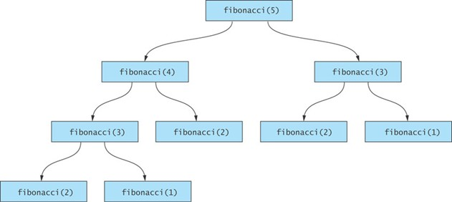
Fibonacci Numbers
int fibonacci(int n) {
if (n == 1)
return 1;
else if (n ==0)
return 0;
else
return fibonacci(n – 1) + fibonacci(n – 2);
}
Because of the redundant function call the time required to calculate Fibonacci(n) increases exponentially with n.

Slide 22
Multiplication of two natural number
The approach and Example:
5*1=5
1*5=5
So, if any of the numbers is 1, then the product is the other number. That is the basic case.
But if neither of the numbers is 1, then we basically add the first number each time, by reducing the value of the second number by 1:

Slide 23
Multiplication of two natural number
Example: 5*4 can be written as:
5+(5*(4-1))
=5+(5*3)
=5+5+(5*(3-1))
=5+5(5*2)
=5+5+5+(5*(2-1))
=5+5+5+(5*1) //From the first and second example, anything multiplied by the 1 is itself.
=5+5+5+5=20
PsuedoCode
product(x,y) {
if(x==1)
return(y);
else if(y==1)
return(x);
else
return(x+product(x,y-1));
}

Slide 24
Recursion Examples: TOH
Tower of Hanoi is a mathematical puzzle where we have three rods (A, B, and C) and N disks.
Initially, all the disks are stacked in decreasing value of diameter i.e., the smallest disk is placed on the top and they are on rod A. The objective of the puzzle is to move the entire stack to another rod (here considered C), obeying the following simple rules:
Only one disk can be moved at a time.
Each move consists of taking the upper disk from one of the stacks and placing it on top of another stack i.e. a disk can only be moved if it is the uppermost disk on a stack.
No disk may be placed on top of a smaller disk.

Slide 25
Recursion Examples: TOH
void hanoi(int n, char A, char B, char C){
if(n==1){
printf("Disk 1 moved from %c to %c \n",A,C);
return;
}
hanoi(n-1,A,C,B);
printf("Disk %d moved from %c to %c \n",n,A,C);
hanoi(n-1,B,A,C);
}

Slide 26
Reversing an integer
int revNumFunction(int num){
if(num){
rem=num%10;
sum=sum*10+rem;
revNumFunction(num/10);
}
else
return sum;
}

